Slide 1
Progress on the Industrial Use Cases
Model Writer

Slide 2
UC-FR-01 - Synchronization between models and documents
Yvan lussaud
OBEO

Slide 3
UC-FR-01 Synchronization between models and documents
Sirius
Development of Sirius
Problematic
Concern

Slide 4
UC-FR-01 Sirius
Open source Eclipse project
Creates graphical modelers
Easy to use (Diagram, table, tree, …)
Domain Specific language
View point approach

Slide 5
UC-FR-01 Development of Sirius
Graphical Mapping DSL
Source code
Documentation (specifier, user)
Life cycle
Artifacts
Release train Eclipse
Dependencies
Team
Core team
External contributors
Methodology
Code review
Plan manual synchronization of artifacts

Slide 6
UC-FR-01 Problematic
Synchronization gap
Validation
Development
Release
Artifacts knowledge is volatile
Quality

Slide 7
UC-FR-01 Concern
Internal validation of ModelWriter approach
Contribute to Intent
Mapping tooling
Live validation feedback
Batch validation
Fixing assistance

Slide 8
UC-FR-02 - Enterprise Architecture
Yvan lussaud
OBEO

Slide 9
UC-FR-02 Enterprise Architecture
SmartEA
Enterprise Architecture
Problematic
Concern

Slide 10
UC-FR-02 SmartEA
Centralize information
Ease communication in the company
Support changes in the company
Model the company
Business opportunities, business changes, interoperability, new technologies
Gap analysis
Technical information
View point approach
Impact analysis
Eclipse and Sirius editors
Internal model can be changed (TOGAF9, BPMN, …)
Web portal

Slide 11
UC-FR-02 Enterprise Architecture
Define As-Is state
Import documents
Define To-Be state
Modify the company model
Consolidate the company model
Define trajectories
Gap analysis
Impact analysis
Define milestones
Identify possible scenario
Evaluate possible scenario

Slide 12
UC-FR-02 Problematic
Validation
Organizational changes
Produce documentation of organizational changes
Artifacts knowledge is volatile
Quality
Synchronization gap
Documentation
Keep track of sourced documents
Keep representation and portal up-to-date

Slide 13
UC-FR-02 Concern
Industrial use of ModelWriter tooling
Contribute to Intent
Mapping tooling
Live validation feedback
Batch validation
Fixing assistance

Slide 14
UC-FR-03 - Synchronization of Regulation Documentation with a Design Rule Repository
Anne MONCEAUX
Airbus Group Innovation
Louis ROUCH, Ayhan MOHOVIC
Airbus SAS

Slide 15
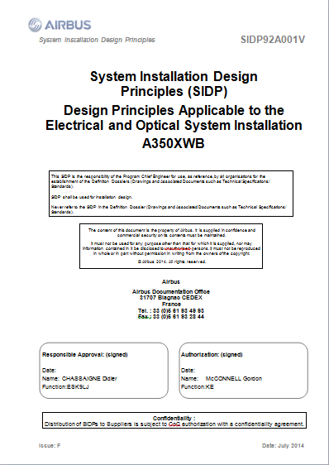
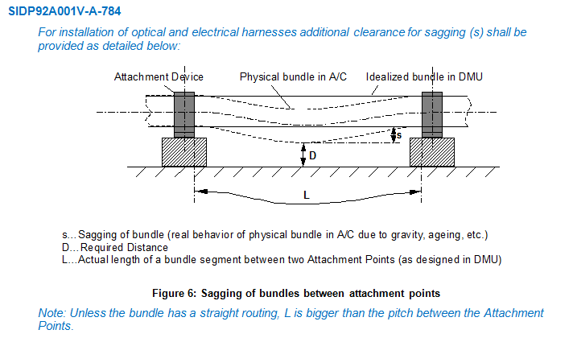
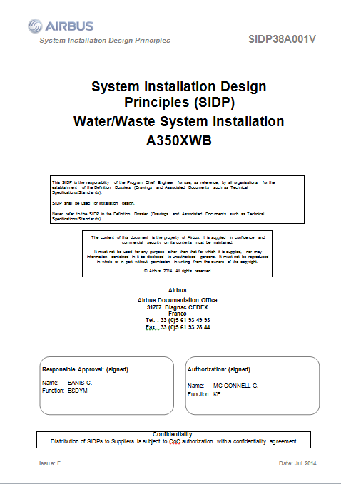
SIDP: “System Installation Design Principles”
Notes:
SIDP is used (under Non Disclosure agreement) as a use case

Slide 16
Context and problem
SIDP documents explain how to install the aircraft systems and attach them to the structure. They capitalize the best practices & proven technical solutions.
SIDP are defined per ATA chapter (~functional domain) to be applied for each given A/C project: for example “A350 Electrical installation”
SIPD are open to Extended Enterprise: installation tasks are performed by risk sharing partners.
SIDP are living documents: during the aircraft development any new DP allowing to satisfy all targets/constraints can be added, assuming it is validated by Airbus dedicated committee.

Slide 17
Industrial high level needs
To improve SIDP creation, maintenance and consultation in order to:
save costs by supporting DP consultation / retrieval in accordance to the needs
avoid non-compliance of design caused by DP updating lead times
keep traceability with upstream regulations and requirements and downstream design models

Slide 18
Synchronization of regulation documentation with a design rule repository

Slide 19

UC-FR-03 Synchronization of regulation documentation with a design rule repository
Goal: synchronizing the SIDP database content with documentation
Create links between text fragments & model elements (manual annotation?, semi-automatic?…)
Manage consistent synchronization (manage changes)

Slide 20
UC-FR-03 Synchronization of regulation documentation with a design rule repository
Approach: limited case on Electrical Installation functional domain
(Confidential Data - Non Disclosure Agreement finalized in June 2015).
Text
1 document: SIDP ATA 92
In our industrial context SIDP are edited using MSWord
Models
An OWL model is built that reflects the DB schema: “Rule ontology” (30 classes, 35 object properties and 54 data properties)
Automatic population mechanism of the model from a csv BD export produces the KB (45781 triples)
Notes:
Why an OWL model?
- Natural

Slide 21
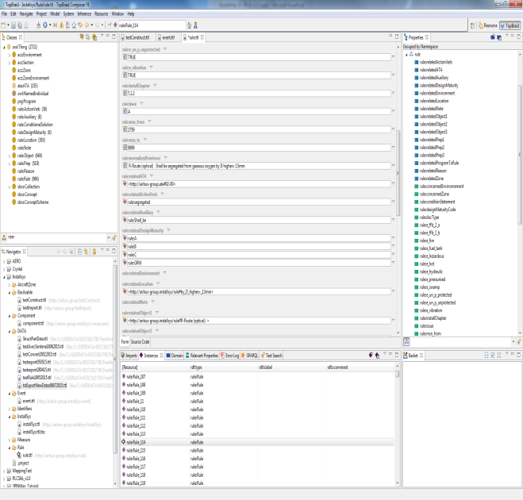
UC-FR-03 Synchronization of regulation documentation with a design rule repository
Status 1st iteration: synchronizing the SIDP KB content and text part
Thermal variation shall be taken into account
Structural deformation shall be taken into account
Pressurization Variation shall be taken into account
Component/Item/Object shall be qualified to withstand temperature reached by the routes they are in contact with
Model part = rule KB
Textual part = rule sentences

Slide 22
UC-FR-04 - Production of a Context Specific Design Document
Anne MONCEAUX
Airbus Group Innovation
Louis ROUCH, Ayhan MOHOVIC
Airbus SAS

Slide 23
UC-FR-04 Production of a context specific design document
Goal: producing document according to usage “needs”
Produce “filtered” document with subset of Design Principle textual elements according to usage “needs”

Slide 24
UC-FR-04 Production of a context specific design document
Approach:
use case Electrical Installation functional domain
Confidential Data - Non Disclosure Agreement finalized in June 2015
Use model elements to retrieve relevant Design Principles
Text
1 document: SIDP ATA 92
In our industrial context SIDP are edited using MSWord
Models
The previous Rule KB (populated Rule ontology)
Component ontology (476 classes, 21 ObjectProperties and 35 DataProperties)
Notes:
Why an OWL model?
- Natural

Slide 25
Component classes taxonomy
ObjectProperties
Component
Assembly
“Structural_Element”
subClassOf
“Bracket”
Physical component
Attachment device
“Fastener”
“Pclamp”
Clamp
AnnotationProperties
Rdfs:label
“Assembly”
Skos:prefLabel
P-Clamp
P-Clamp NSA5516

Slide 26
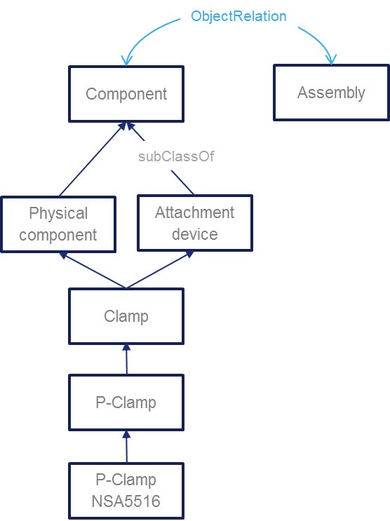
Component classes taxonomy
“P-clamp NSA5516 can be fixed on X with Y”
“Physical component”
“Standard reference”
NLP Parsing uses this taxonomy. Labels + assumptions such as a physical component may be referred to using its name or its reference or both concatenated
Inference rule: a rule applying to a component type (Attachment device) applies to its subtypes (P-clamp)
Document display : when searching rules applying to a component type (P-Camp) → retrieve and display rules applying to super-types

Slide 27
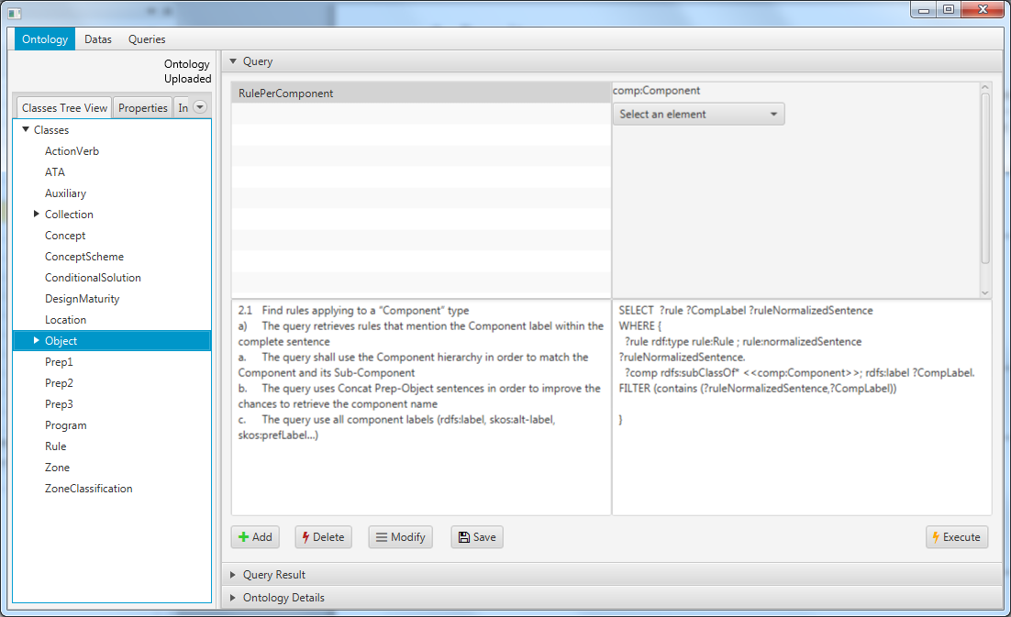
SPARQL queries
Status : model based queries specification
Preliminary study with Loria (Text to RDF)
1 internship on RDFizer and Query management

Slide 28
UC-TR-01 - Documents of Quality Assurance Department
Ersan GÜRDOĞAN
HISBIM

Slide 29
UC-TR-01 Documents of Quality Assurance Department
UC-TR-01 | Documents of Quality Assurance Department
Version | V1.0.0 dated 15-Nov-2014
Description | To create faster and more accurate the forms that are used in quality control progress and trigger related forms (re-work form triggering, revision needed, approved, rejected etc.)
Actors | Quality Managers, Quality Measurement Specialists, Quality Control Personnel, Quality Auditors, Production Crews
Assumptions | Quality control measurement units are standard Rejected and Approved products forms are standard Quality Certification standards are always applied
Steps | Products information forms are created according to product information comes from ModelWriter system Products are measured by quality control department authorized personnel's according to standards To decide product is standard or not according to measurement report Product would be sent rejected products section if its measures are out of standards ModelWriter system is created Rejected Product Quality Form Else Approved Product Quality Form is created by ModelWriter System Approved products are sent to warehouse as accepted products
Alternatives | If rejected products' measurement out of range in rework standards, it means cannot be applied rework on this product, it returns to scrap. Then it should be sent wasteland.
Issues | Standardizing form designs is hard because of all customers have their own unique reporting tools/formats

Slide 30
UC-TR-02 - Non-Disclosure Agreements
Ersan GÜRDOĞAN
HISBIM

Slide 31
UC-TR-01 Non-Disclosure Agreements
UC-TR-02 | Non-Disclosure Agreements
Version | V1.0.0 dated 15-Nov-2014
Description | Non-Disclosure Agreement (NDA), also known as a confidentiality agreement (CA), confidential disclosure agreement (CDA), proprietary information agreement (PIA), or secrecy agreement (SA), is a legal contract between at least two parties that outlines confidential material, knowledge, or information that the parties wish to share with one another for certain purposes, but wish to restrict access to or by third parties. It is a contract through which the parties agree not to disclose information covered by the agreement. An NDA creates a confidential relationship between the parties to protect any type of confidential and proprietary information or trade secrets. As such, an NDA protects nonpublic business information. NDAs are commonly signed when two companies, individuals, or other entities (such as partnerships, societies, etc.) are considering doing business and need to understand the processes used in each other's business for the purpose of evaluating the potential business relationship. NDAs can be "mutual", meaning both parties are restricted in their use of the materials provided, or they can restrict the use of material by a single party. It is also possible for an employee to sign an NDA or NDA-like agreement with an employer. In fact, some employment agreements will include a clause restricting employees' use and dissemination of company-owned confidential information.
Actors | Responsible/Authorized personnel in both parties.
Assumptions | Agreements are prepared and written according to European Business Law.
Steps | To define both partied who would sig the NDA To write items of agreement according to scope of NDA Reviewing agreement by decision maker then getting approval Sharing NDA each other Send feedback to ModelWriter system if any change apply on NDA Sharpen final version of NDA then signing by both parties
Alternatives | After sharing NDA, both parties sign without any change and no feedback. Cancellation of NDA
Issues | Different laws could be applied in out of European Union

Slide 32
UC-TR-03 - Synchronization of ReqIF models from requirement specifications
Ferhat Erata
UNIT

Slide 33
UC-TR-03 - Synchronization of ReqIF models from requirement specifications
Technical documents are usually long and have complex structure
For example requirement or specification documents
These documents keep changing in the time frame and need to be consistent with the other artifacts
For example, with a ReqIF model
In this use case we aim to keep these documents and models synchronized
This will include bidirectional transformation of documents and models
Notes:
ReqIF is widely used standard to interchange requirements between partners, esp. İn automative industry.

Slide 34
UC-TR-03 - Synchronization of ReqIF models from requirement specifications
Specification
Document
Technical Document
Doc Model
Synchronization
Transformation
ReqIF Models
Synchronization Transformation
Requirement Document
At the current progress status of this UC:
The transformation is done in one way (left to right)
The synchronization is done only between DocModel and ReqIF models

Slide 35
UC-TR-03 - Synchronization of ReqIF models from requirement specifications
Sample Applications:
Airbus SIDP templates ⬄ ReqIF
Havelsan Requirement doc templates ⬄ ReqIF
University Management System docs ⬄ ReqIF
Eclipse RMF specifications ⬄ ReqIF
The initial implemented version of this use case will be presented in the demonstration session.

Slide 36
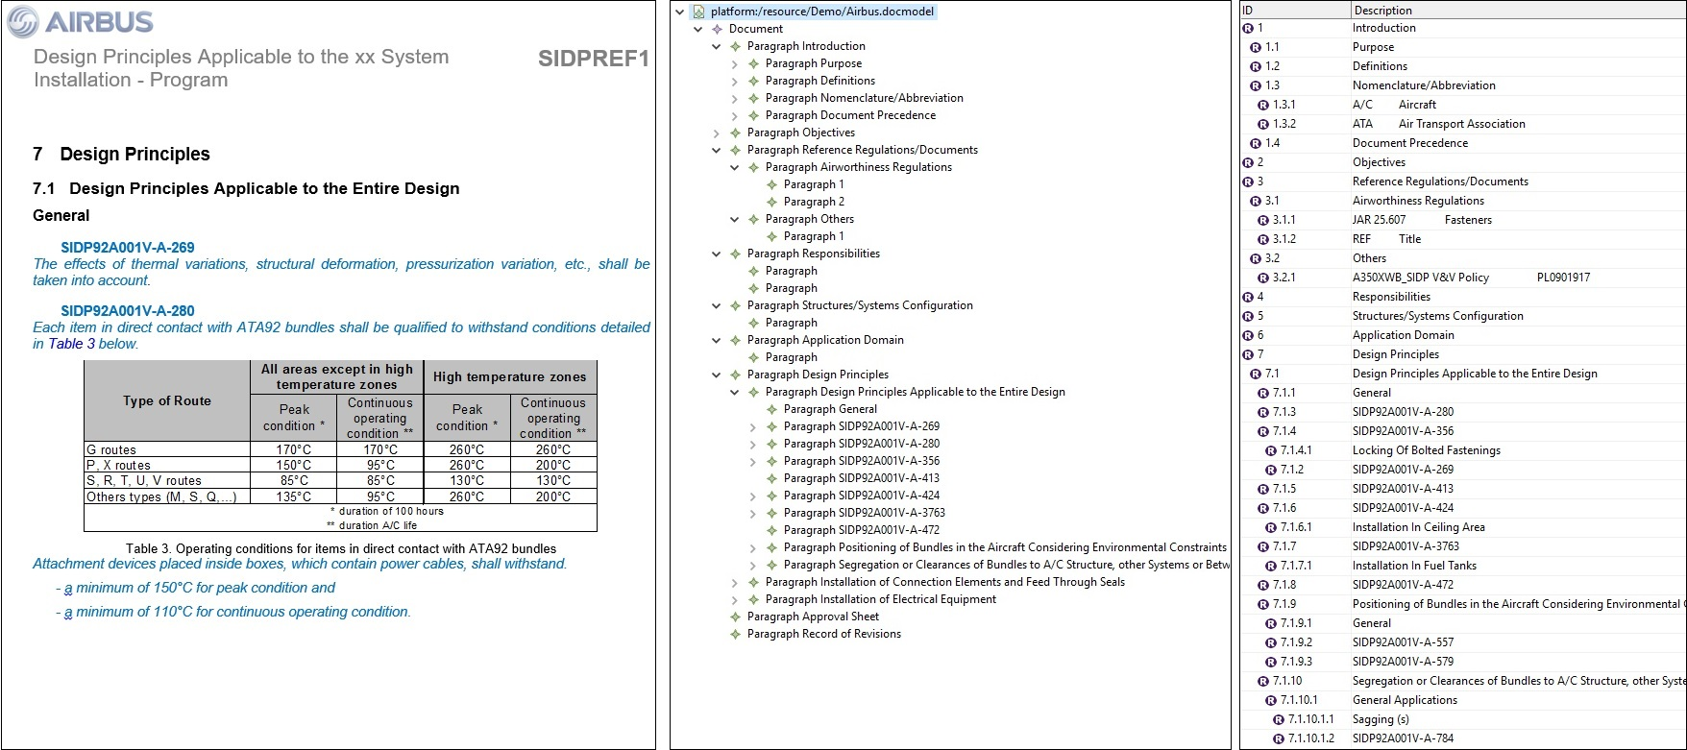
UC-TR-03 Screenshots - Airbus SIDP templates

Slide 37
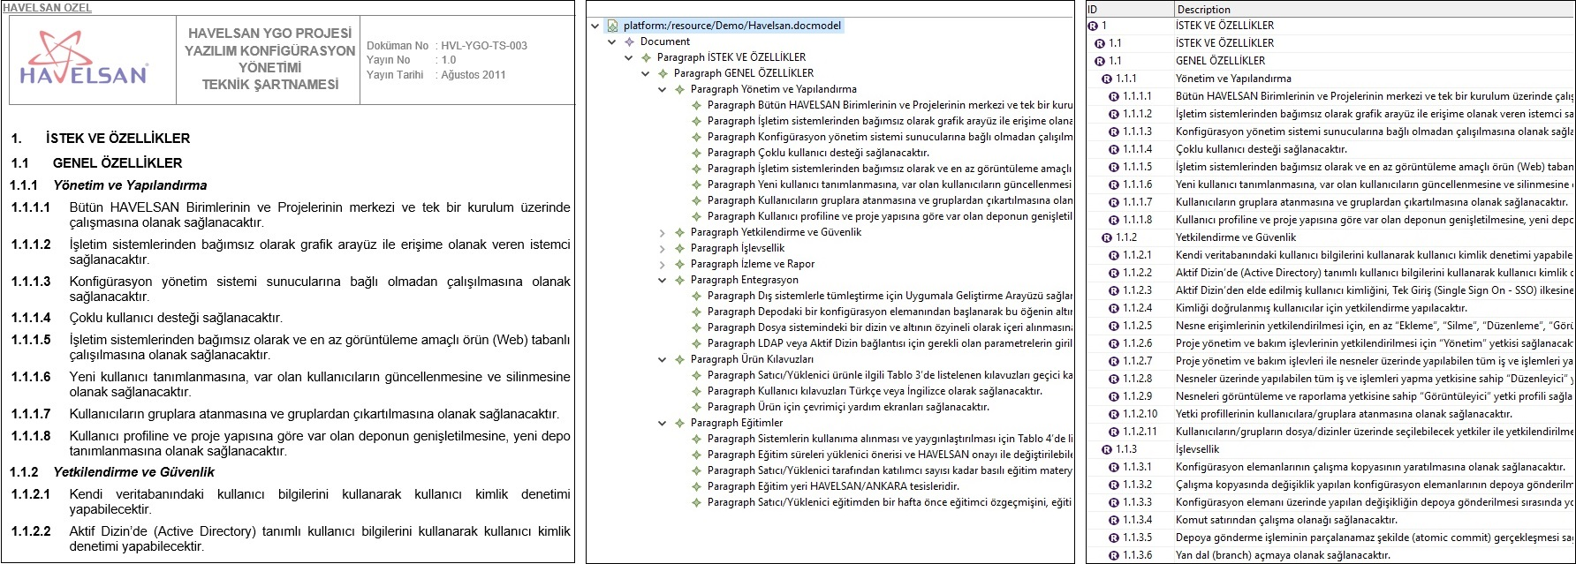
UC-TR-03 Screenshots - Havelsan Requirement docs

Slide 38
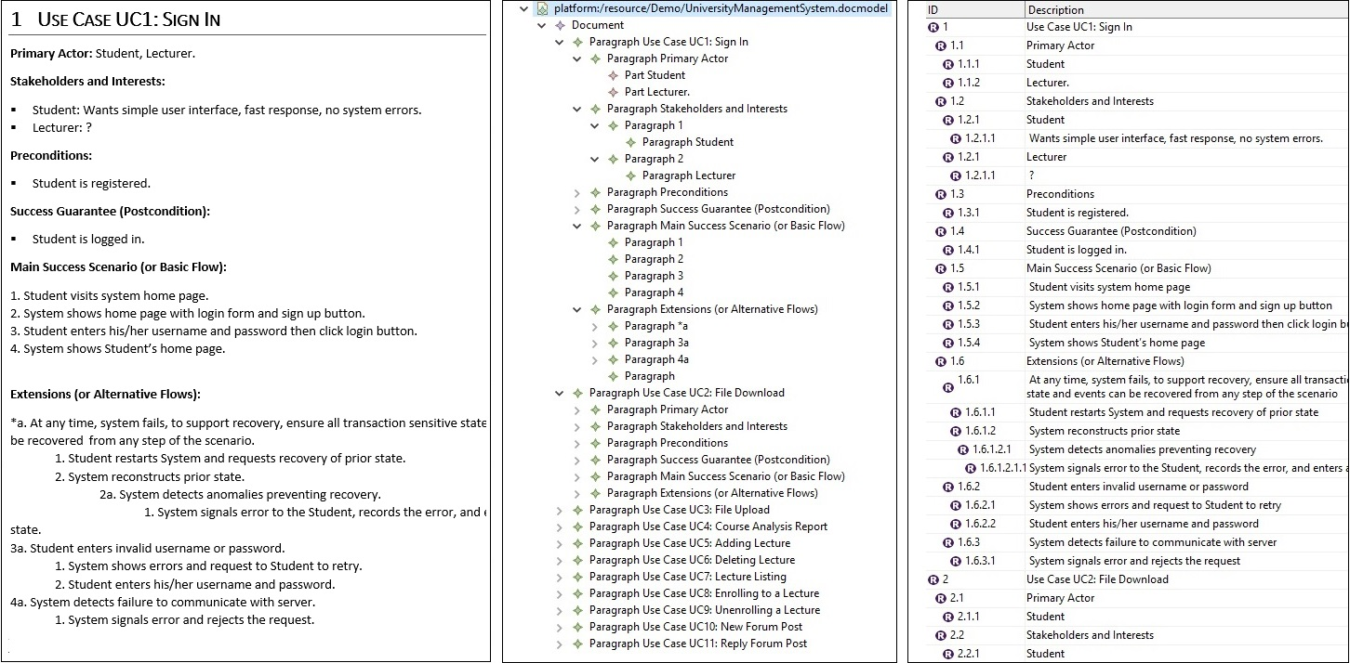
UC-TR-03 University Management System docs

Slide 39
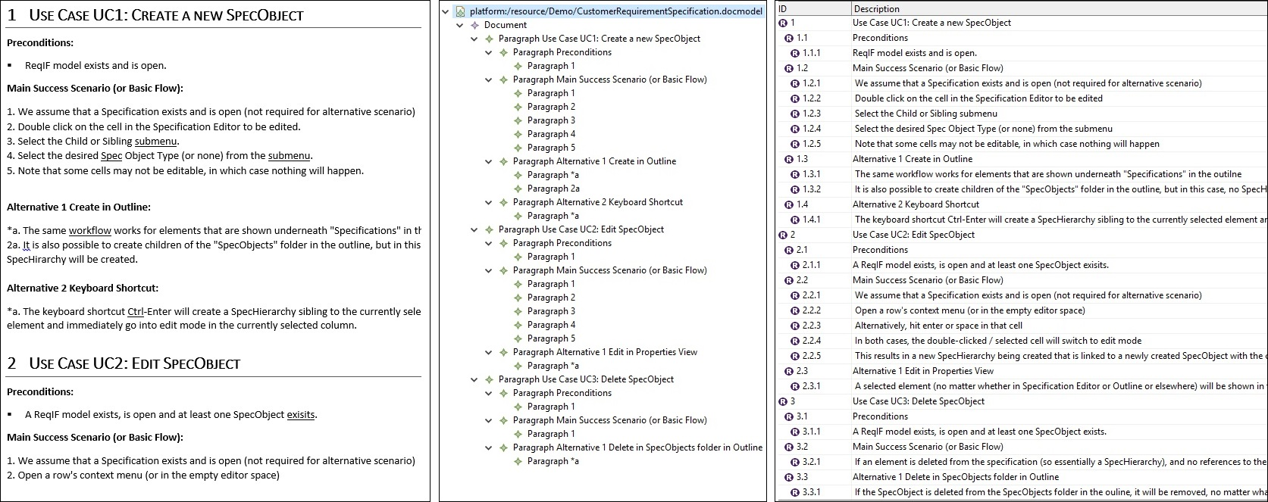
UC-TR-03 Screenshot - Eclipse RMF specifications

Slide 40
Next Steps
Next steps:
ReqIF model transformation to documents (bi-directional transformation)
Synchronization between a document and Doc-Model (fully synchronization)

Slide 41

Model Writer
Work Package 1 - Industrial Use Cases and Requirements
Integration with Application Lifecycle Management tools
Eray TÜZÜN (HAVELSAN )
Yagup MACİT (HAVELSAN)

Slide 42
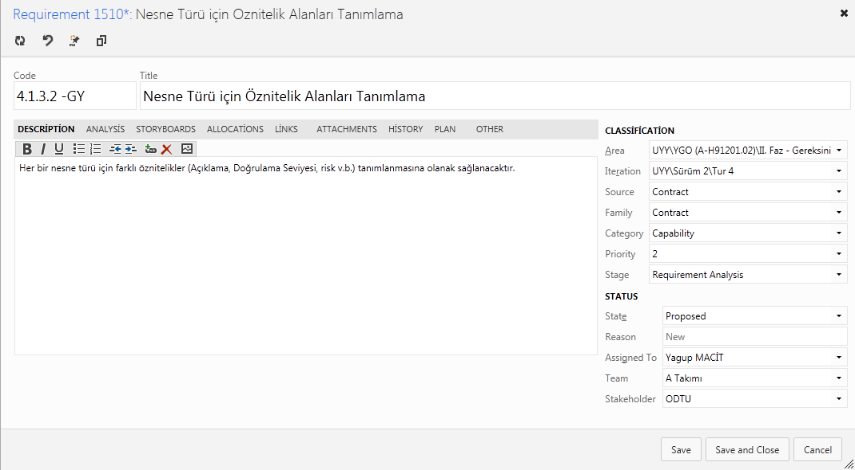
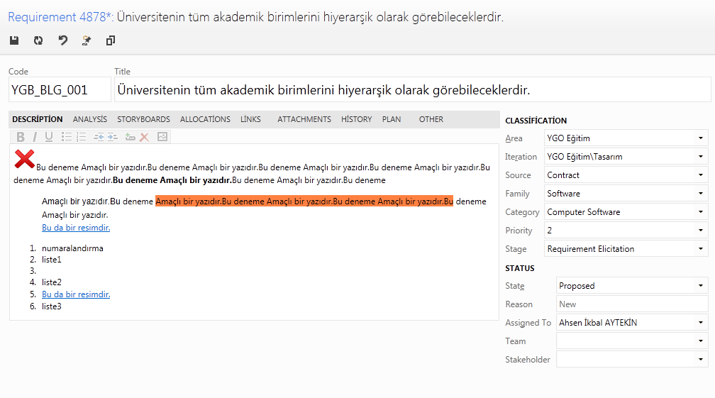
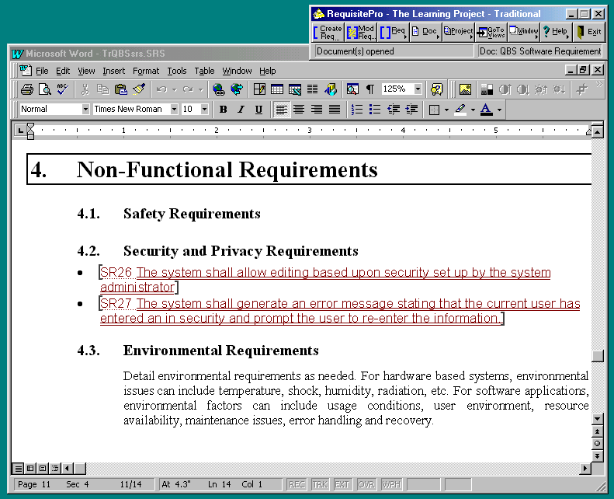
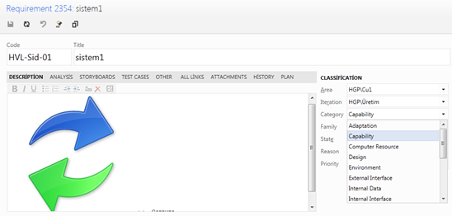
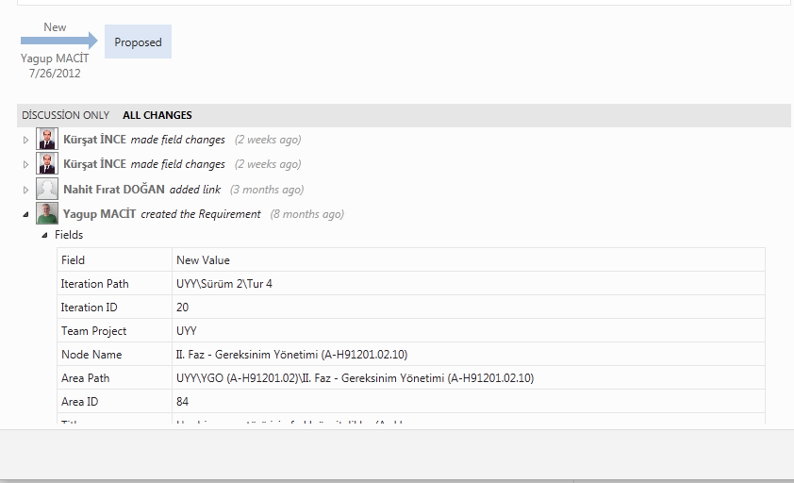
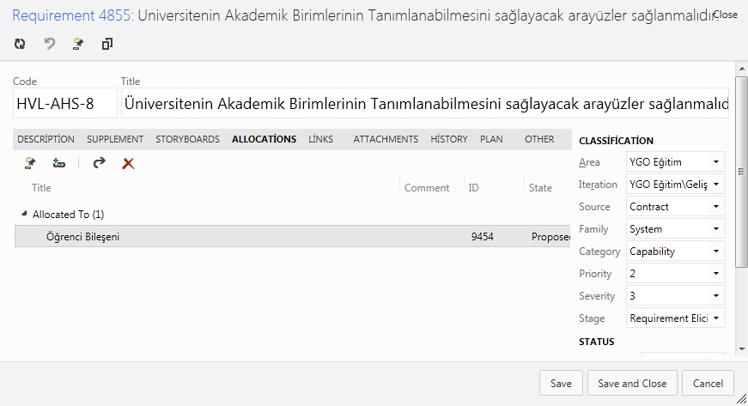
Requirement Work Item
Customized Form
Attributes
WorkItem Number Patterns
History
Discussion

Slide 43
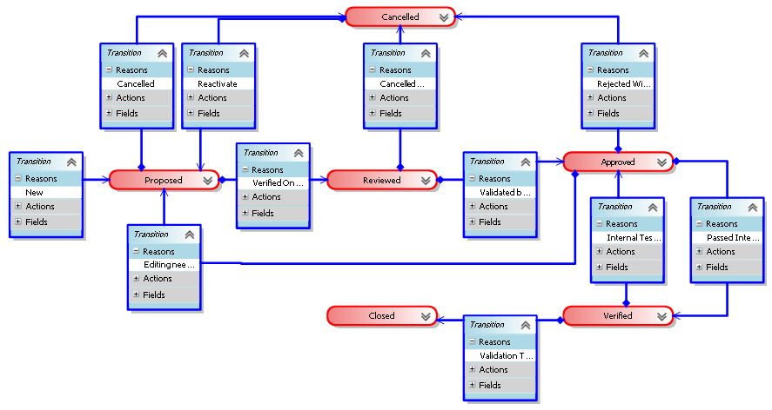
Requirement LifeCycle
Notes:
We defined a structured requirement object as an entity, that have a set of lifecycle states, defined transitions between these states, history of changes, related attributes (unique id, priority, severity, validation method etc.), and traceability information to various project artefacts such as other requirements, design model, source code, bugs, test cases etc.

Slide 44
Requirements Traceability

Slide 45
Requirements in ALM

Slide 46
Requirements in ALM
Traceability with other artifacts is key
Requirements to other requirements
Customer/System/Software/Hardware..
Dependency relation between requirements
Requirements to tasks (Project management)
Requirements to Test Cases
Requirements to Design elements
Requirements to generated documents
Requirements to source code
Requirements to Build
Requirements to bugs
Requirements to risks
…
Notes:
Requirements Engineering is not a separate activity. It is part of ALM. Requirements as a document or a separate entity does not mean anything.
A lot of the big software development companies have made a lot of investments to build an integrated ALM platform which would cover the entire lifecycle of an application.
This Use Case aims at integrating ModelWriter with requirements management portion of the Application Lifecycle Management (ALM) tools. In a typical ALM platform, “requirement” is represented as a structured requirement object rather than text.

Slide 47
HAVELSAN Use case for ModelWriter
Currently we support scenario #1 and #4, and interested in Scenario #3, #2

Slide 48
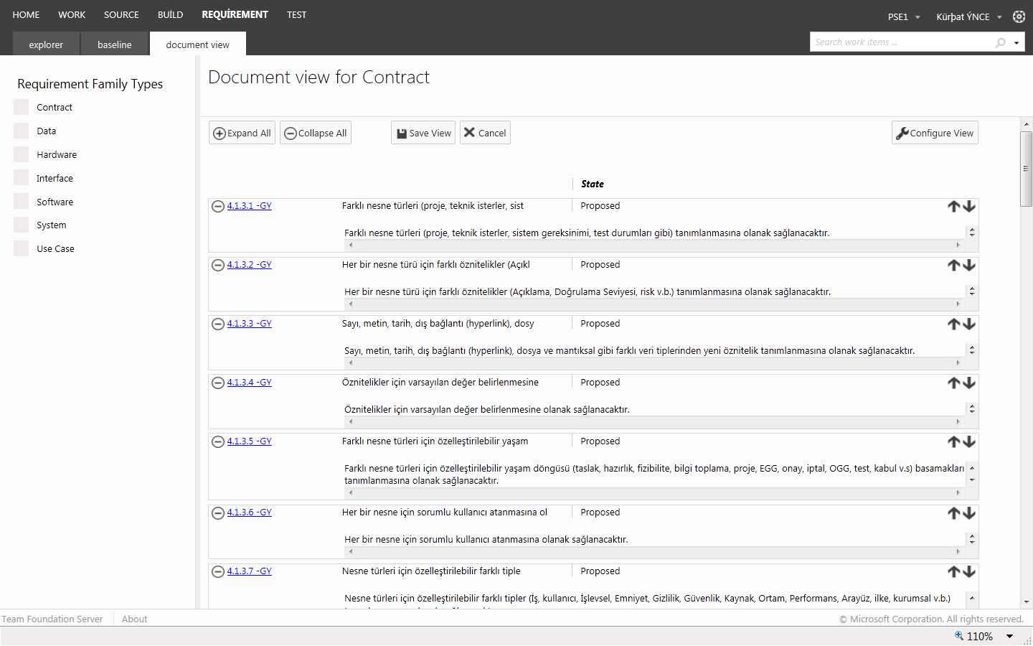
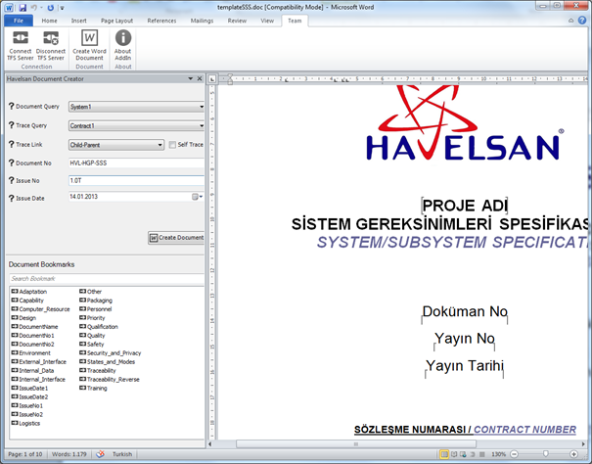
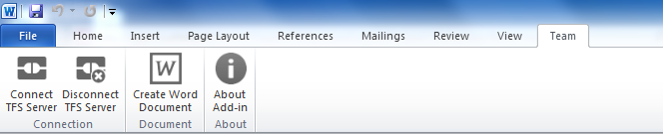
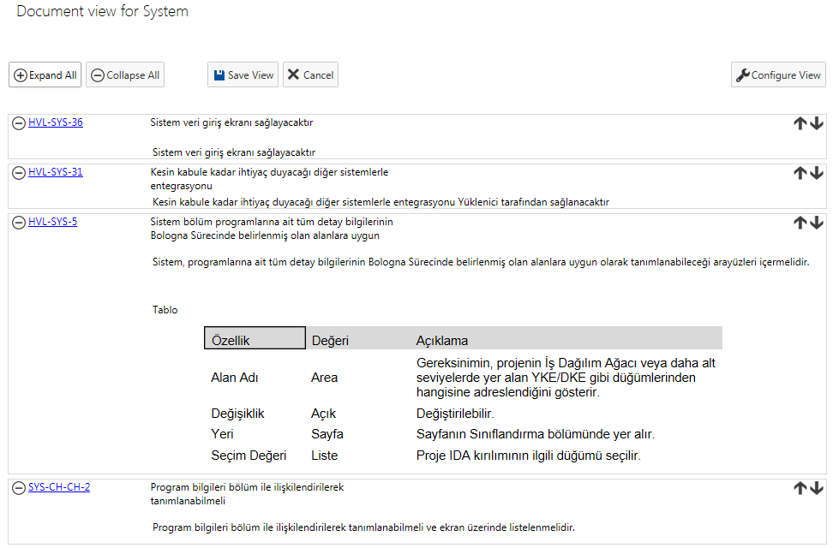
Havelsan Ext - Document Generation
Preview
Word Extension
Support for Templates

Slide 49
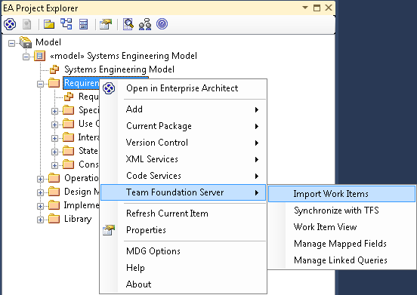
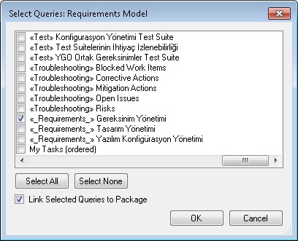
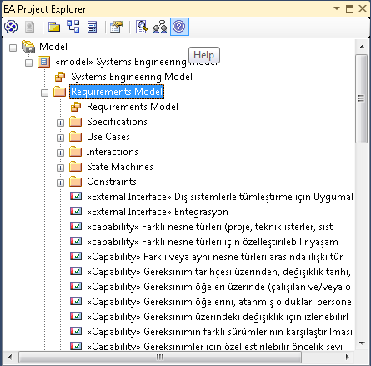
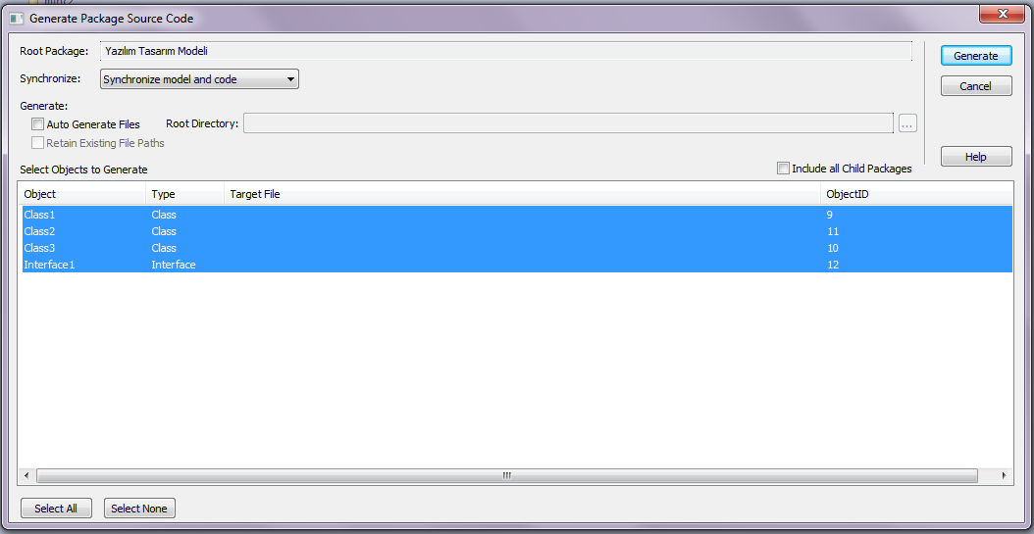
Requirements - Design Model Traceability
Requirements would be imported to the Design tool for traceability.
Code generation from design

Slide 50
UC-TR-05 - Synchronous Business Process Design with Use Cases
Geylani Kardaş
KoçSistem

Slide 51
UC-TR-05 - Synchronous Business Process Design with Use Cases
Use cases are one of the main approaches to represent the requirements.
A use case is a list of actions or event steps, typically defining the interactions between a role (a.k.a actor in the UML).
BPMN provides a graphical notation for specifying the processes in a diagram based on a flowcharting technique (similar to activity diagrams in UML).
The aim is to support business process management, for both technical and business users, by providing a notation which enables to represent complex process semantics.
However, the transformation and synchronization of use cases and BPMN models are challenges addressed in this UC.

Slide 52
UC-TR-05 - Synchronous Business Process Design with Use Cases
Use case Documents
Synchronization
Transformation
BPMN Models
Applications:
- University Management System Use cases docs ⬄ BPMN
- Eclipse RMF use case specifications ⬄ BPMN
At the current state of progress this UC:
The transformations are done in one way (left to right)

Slide 53
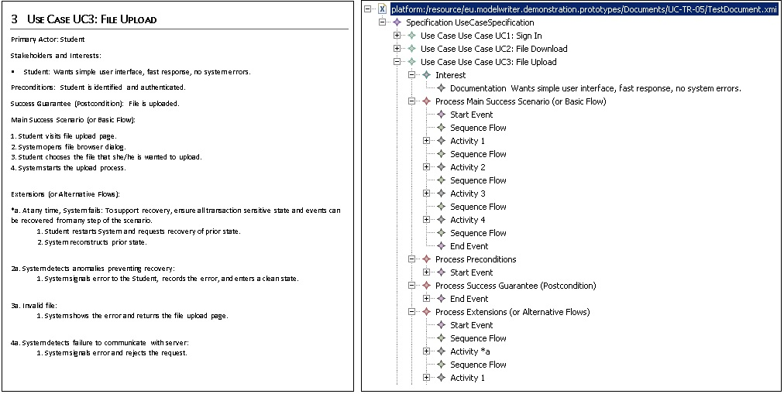
UC-TR-05 University Management System Use cases

Slide 54
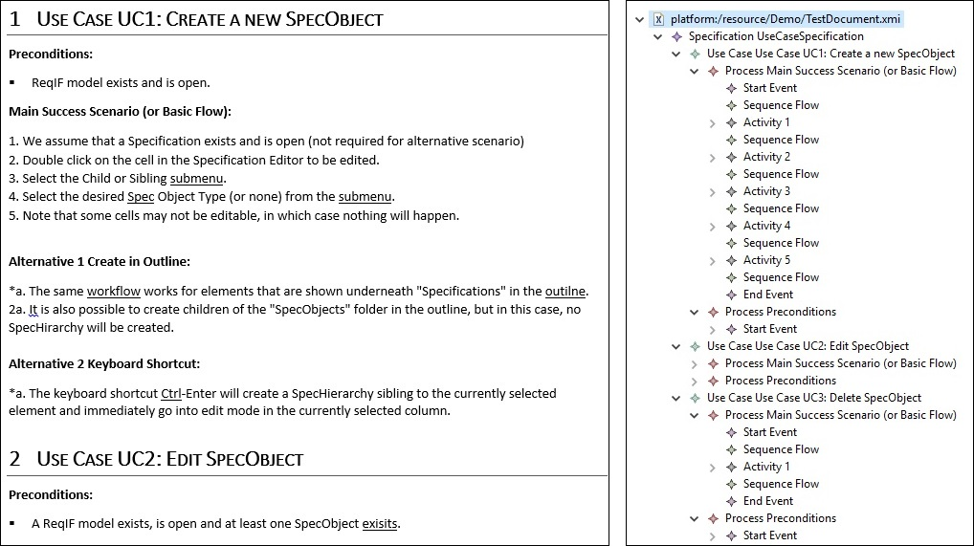
UC-TR-05 Eclipse RMF use case specifications

Slide 55
UC-TR-05 - Synchronous Business Process Design with Use Cases
Demonstration:
The initial implemented version of this use case will be presented in the demonstration session.
Next steps:
BPMN model transformation to Use case documents (bi-directional transformation)
Synchronization between documents and BPMN Models
Using technique documents of Ford-Otosan;

Slide 56
Thank you for your attention! Any question ?

